Slide 1
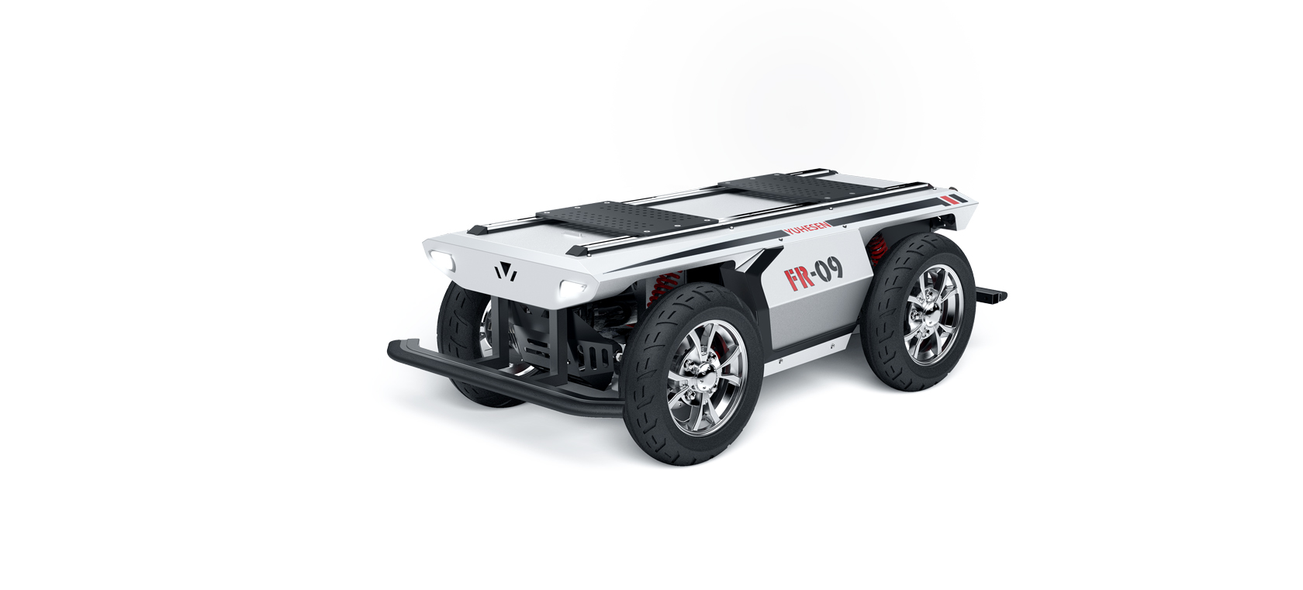
DIPARTIMENTO DI INGEGNERIA ELETTRICA E TECNOLOGIE DELL’INFORMAZIONE
SCUOLA POLITECNICA E DELLE SCIENZE DI BASE
MASTER'S DEGREE IN AUTOMATION ENGINEERING AND ROBOTICS
Field and Service Robotics project
Navigation planning and control of car-like robot
Candidate: Manzoni Antonio
Supervisor: Prof. Fabio Ruggiero
YUHESEN FR-09 PRO

Slide 2
Index
Aim of the project
Kinematic model of car-like robot
Navigation planning
RRT* with Pseudo-Clothoid curves
Dijkstra and A* algorithms with Reeds-Sheep curves exploration
Input-Output Linearization control
Simulations and results
2/28

Slide 3
Aim of the project
NAVIGATION PLANNING
A smooth path planning algorithm is implemented to determine the trajectory for car-like robots. Three different strategies of path planning are introduced:
RRT* with Pseudo-Clothoid curves
Dijkstra and A* algorithms with Reeds-Shepp Curves
INPUT-OUTPUT LINEARIZATION CONTROL
Given the trajectory in the previous point, an Input/Output Linearization control approach is implemented to control the position of car-like robot.
3/28

Slide 4
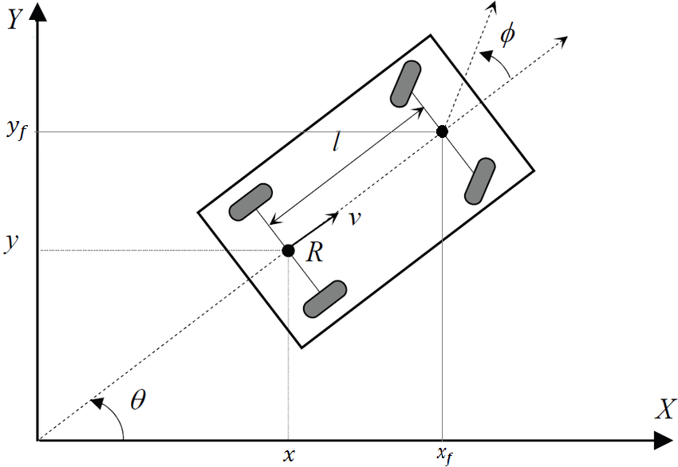
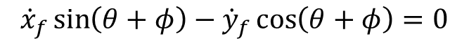
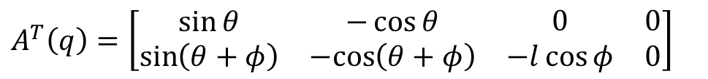
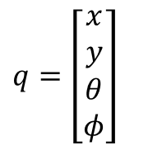
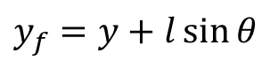
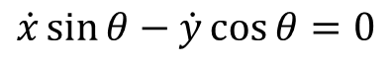
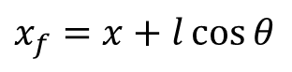
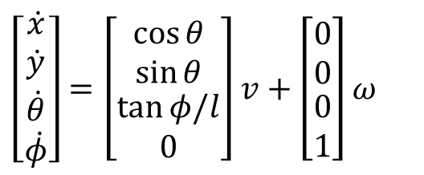
Car-like robot: kinematic modeling
Two nonholonomic constraints, one for each wheel (pure rolling constraints)
Kinematic model (rear-wheel driving)
$$\left[\begin{matrix}\begin{matrix}\dot{x} \\ \dot{y}\end{matrix} \\ \begin{matrix}\dot{θ} \\ \dot{φ}\end{matrix}\end{matrix}\right]=\left[\begin{matrix}\begin{matrix}\cos{θ} \\ \sin{θ}\end{matrix} \\ \begin{matrix}\tan{φ/l} \\ 0\end{matrix}\end{matrix}\right]v+\left[\begin{matrix}\begin{matrix}0 \\ 0\end{matrix} \\ \begin{matrix}0 \\ 1\end{matrix}\end{matrix}\right]ω$$
$$\dot{x}\sin{θ−\dot{y}\cos{θ}{=0}}$$
$${\dot{x}}_{f}\sin\left(θ+φ\right)−{\dot{y}}_{f}\cos\left(θ+φ\right)=0$$
Using rigid-body constraints
$$x_{f}=x+l\cos{θ}$$
$$y_{f}=y+l\sin{θ}$$
the second kinematic constraint becomes
$$q=\left[\begin{matrix}\begin{matrix}x \\ y\end{matrix} \\ \begin{matrix}θ \\ φ\end{matrix}\end{matrix}\right]$$
$$\dot{x}\sin\left(θ+φ\right)−\dot{y}\cos\left(θ+φ\right)−\dot{θ}l\cos{φ}=0$$
Pfaffian constraint matrix
$$A^{T}\left(q\right)=\left[\begin{matrix}\begin{matrix}\sin{θ} & −\cos{θ} \\ \sin\left(θ+φ\right) & −cos\left(θ+φ\right)\end{matrix} & \begin{matrix}0 & 0 \\ −l\cos{φ} & 0\end{matrix}\end{matrix}\right]$$
4/28

Slide 5
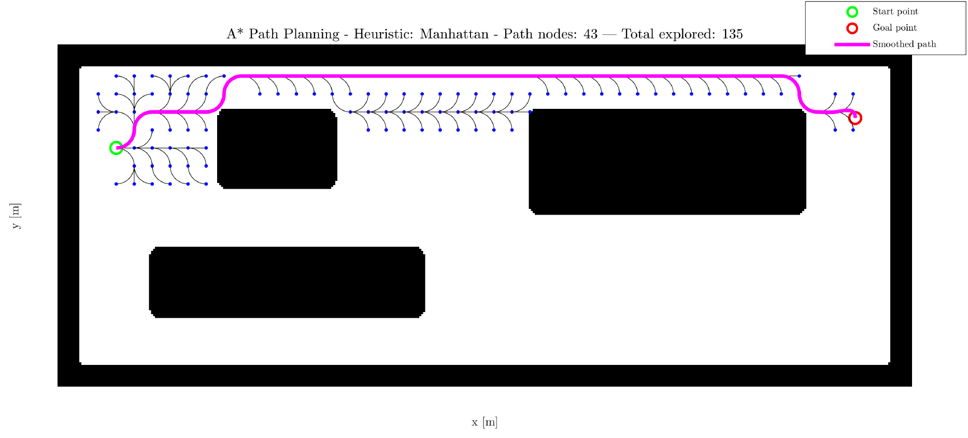

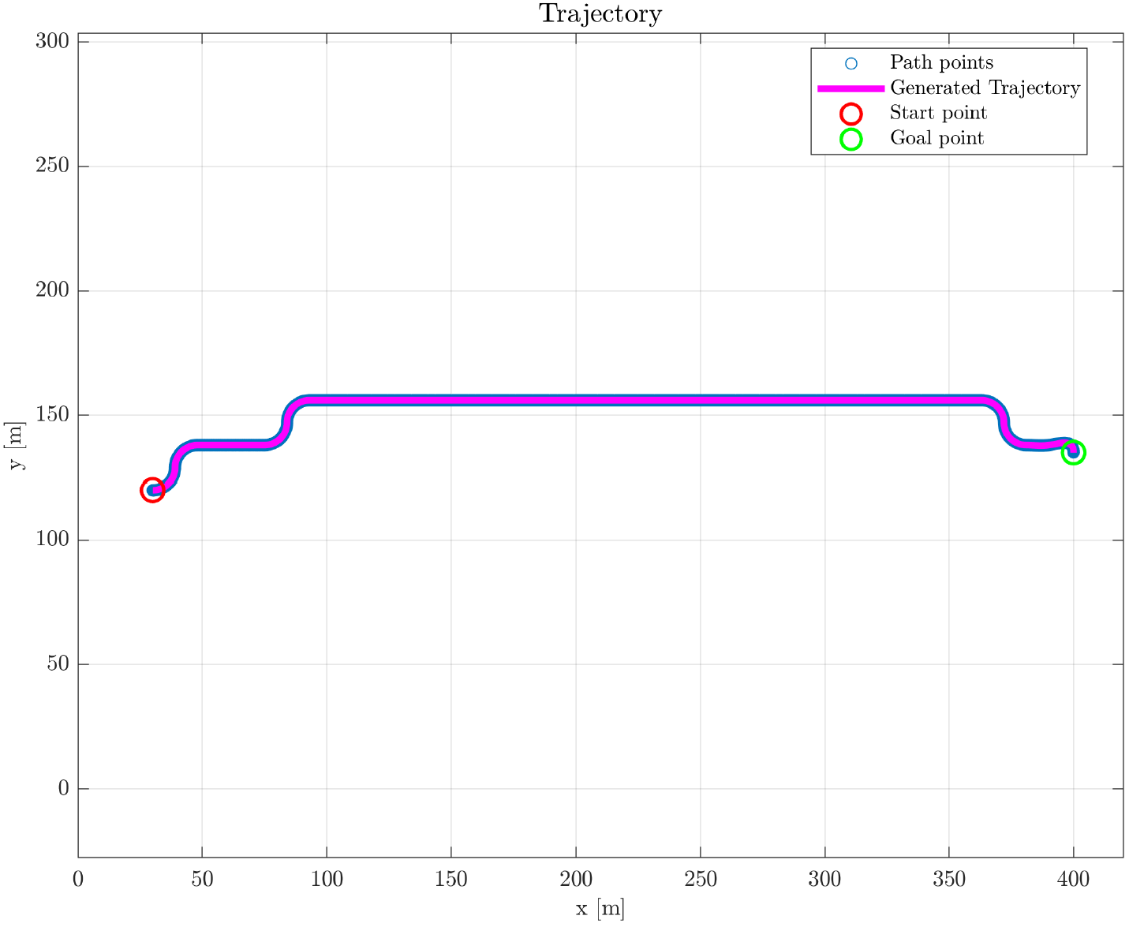
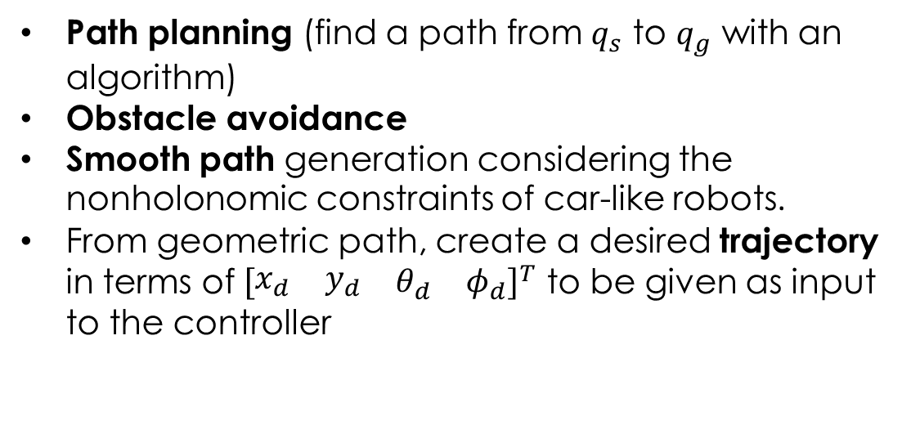
Navigation planning: steps
Path planning (find a path from $q_{s}$ to $q_{g}$ with an algorithm)
Obstacle avoidance
Smooth path generation considering the nonholonomic constraints of car-like robots.
From geometric path, create a desired trajectory in terms of ${\left[\begin{matrix}\begin{matrix}x_{d} & y_{d}\end{matrix} & \begin{matrix}θ_{d} & φ_{d}\end{matrix}\end{matrix}\right]}^{T}$ to be given as input to the controller
5/28

Slide 6
Navigation planning: path planning strategies
Goal: obtain a smooth path
Sampling-based
Search-based
RRT*
Dijkstra algorithm
A* algorithm
Pseudo-Clothoid
Curves
Reeds-Shepp Curves
6/28

Slide 7

Navigation planning: Sampling-based approach (RRT*)
Main loop
Rewiring
Path reconstruction
Random sampling
Finds the closest point to the random point using the Euclidean distance
Computes the new point by steering from the nearest point toward the random point
Checks collisions with obstacles and map boundaries
Finds neighboring nodes within a certain radius and selects the one with minimum cost
Adds the new point to the tree with the minimum-cost node as parent
Examines all neighboring nodes to improve existing paths:
$$∀q_{near}∈Q_{near}:$$
$If cost\left(q_{new}\right)+distance\left(q_{new},q_{near}\right)<cost(q_{near})$:
Reconnects $q_{near}$ to the new node
Updates the cost of $q_{near}$
Propagates the improvement to all descendants
When a node is sufficiently close to the goal reconstructs the complete path from goal to start by following parents
Updates the best path if it has a lower cost than previous ones
7/28
Notes:
cost(qmin) = cost(qnearest) + distance(qmin, qnearest)

Slide 8
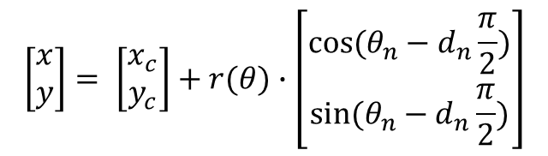
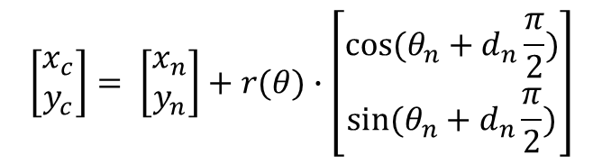
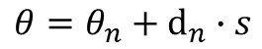
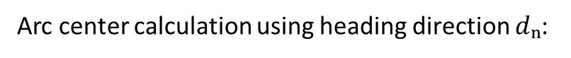
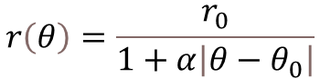

Navigation planning: Pseudo-clothoid curves
To obtain a smooth expansion of the tree, a modified version of the clothoid curves with a variable turning radius has been made.
Parameters
Variable turning radius that decreases as angle increases:
$$r\left(θ\right)=\frac{r_{0}}{1+α\left|θ−θ_{0}\right|}$$
$r₀$: initial radius of the curve
$α$: rate of change of the angle
$|θ − θ₀|:$covered angular distance
$θₙ$: current heading angle
$s$: distance along the curve
$$\left[\begin{aligned}x_{c} \\ y_{c}\end{aligned}\right]= \left[\begin{aligned}x_{n} \\ y_{n}\end{aligned}\right]+r(θ)∙\left[\begin{aligned}cos⁡(θ_{n}+d_{n}\frac{π}{2}) \\ sin(θ_{n}+d_{n}\frac{π}{2})\end{aligned}\right]$$
Arc center calculation using heading direction $dₙ$:
Angle calculation for each curve point:
$$θ=θ_{n}+ⅆ_{n}∙s$$
$$\left[\begin{aligned}x \\ y\end{aligned}\right]= \left[\begin{aligned}x_{c} \\ y_{c}\end{aligned}\right]+r(θ)∙\left[\begin{aligned}cos⁡(θ_{n}−d_{n}\frac{π}{2}) \\ sin(θ_{n}−d_{n}\frac{π}{2})\end{aligned}\right]$$
Coordinates computation without numerical integration:
8/28

Slide 9
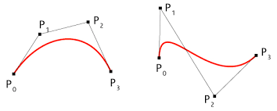
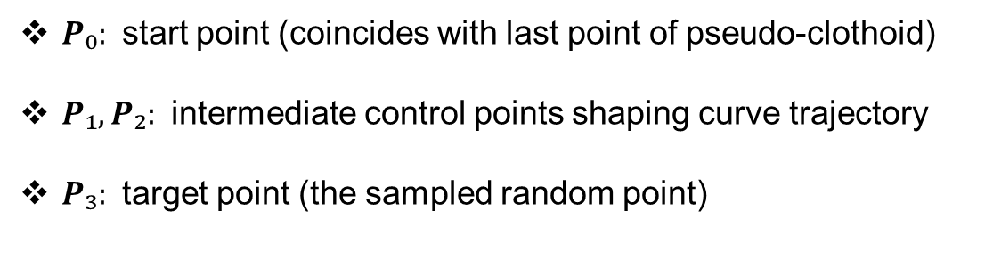
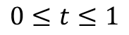
Navigation planning: Bézier termination
Problem: radius might become too small at curve end, creating infeasible curvature
Solution: terminate with a cubic Bézier curve
Cubic Bézier curve equation:
$$B\left(t\right)={\left(1−t\right)}^{3}P_{0}+3{\left(1−t\right)}^{2}tP_{1}+3\left(1−t\right)t^{2}P_{2}+t^{3}P_{3}$$
$$0≤t≤1$$
Control points definition:
$P₀:$start point (coincides with last point of pseudo-clothoid)
$P₁, P₂:$intermediate control points shaping curve trajectory
$P₃:$target point (the sampled random point)
9/28

Slide 10


Navigation planning: Search-based approaches (A*, Dijkstra)
Exploration loop
Path finding
Connection phase
Creates grid representation using Reeds-Shepp curves as motion primitives
Employs a queue-based exploration system, where the queue contains the nodes to explore, initialized with the start point:
Dijkstra: simply selects the first node of the queue (FIFO)
A*: sorts the queue by the total cost $f(n) = g(n) + h(n)$
Generates occupancy matrix tracking obstacles and visited nodes
Builds network of feasible physical connections
Converts exploration results to adjacency matrix (graphs' domain). Adjacency matrix contains node connections and distances
Applies graph search algorithms on network to find the shortest/best path:
Dijkstra: finds shortest path by minimizing distance
A*: finds best path by minimizing $f(n) = g(n) + h(n)$
Works on validated connections from exploration phase
Determines best sequence of movements through network
Connects the start point to the goal point following the path retrieved by the previous phase
Ensures that the continuous path meets the non-holonomic constraints of the robot
(Optional): Implements a smooth forced connection with a spline curve in the last part of the path to reach exactly the goal. This must perform also a final validation for obstacle avoidance
10/28
Notes:
Update of the queue and the occupancy matrix as exploration progresses.

Slide 11
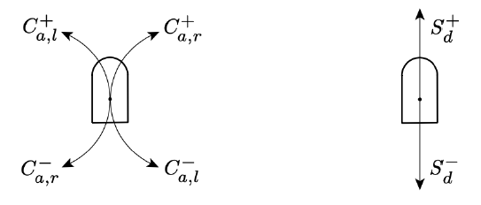

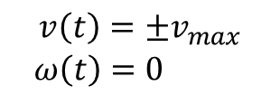
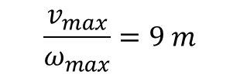

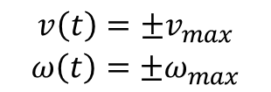
Navigation planning: Reeds-Shepp curves
Dubins Curves
No cusps because the movement is always forward.
Circular arcs of varying lengths traversed with velocities:
$$\begin{matrix}{v\left(t\right)=±v}_{max} \\ {ω\left(t\right)=±ω}_{max}\end{matrix}$$
The radius of these circular arcs is determined by
$$\frac{v_{max}}{ω_{max}}=9 m$$
Linear segments of varying lengths traversed with velocities:
$$\begin{matrix}{v\left(t\right)=±v}_{max} \\ {ω\left(t\right)=0}_{ }\end{matrix}$$
The curves are designed to satisfy the kinematic constraints of the robot, considering only certain Navigation primitives ($C_{a,l}^{+}$ and $C_{a,r}^{+}$ for circular arcs and $S_{d}^{+}$ for linear segments).
Velocity limits:
$$\begin{matrix} v_{max}=5 m/s \\ { ω}_{max}=0.56 rad/s\end{matrix}$$
11/28

Slide 12
Navigation planning: path finding (Dijkstra)
Graph setup
Core algorithm
Works with the adjacency matrix representing valid connections
Creates a distance array initialized to infinity for all nodes
Sets distance to zero for the starting node
Maintains a set of unvisited nodes containing all graph nodes
Iteratively selects unvisited node with minimum distance
For each neighbor connected to current node:
Calculates potential new distance via current node
If new distance is shorter than currently recorded distance:
Updates the distance value
Records current node as the neighbor's predecessor
Marks current node as visited
Continues until all nodes are visited or goal is reached
12/28

Slide 13
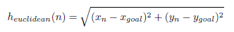
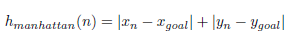

Navigation planning: path finding (A*)
Graph setup
Core algorithm
Works with the adjacency matrix representing valid connections
Initializes the total cost array for each node:
$$f(n) = g(n) + h(n)$$
Where:
$g(n)$: Distance from start node (initially infinity except 0 for start)
$h(n)$: Heuristic estimate to goal using Euclidean or Manhattan distance
Creates priority queue containing all nodes, ordered by f-cost
Iteratively selects unvisited node with minimum f-cost
For each neighbor connected to current node:
Calculates potential new g-cost via current node
If new g-cost is better than current g-cost:
Updates g-cost value
Recalculates f-cost as g-cost + h-cost
Updates predecessor reference for path reconstruction
Marks current node as visited
Terminates when goal is reached or no more nodes to process
13/28

Slide 14
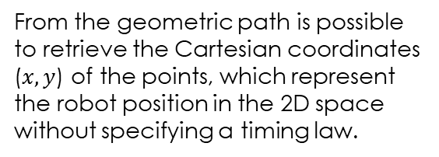
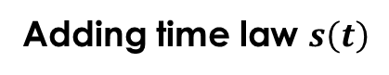

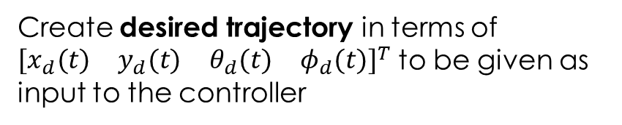
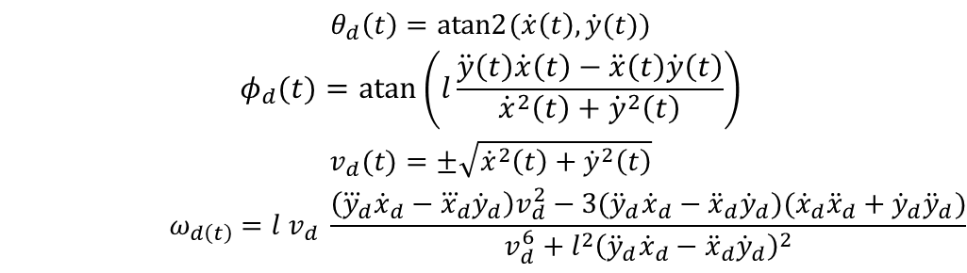
Navigation planning: trajectory
TRAJECTORY = PATH + TIMING LAW
1
Geometric path $q(s)$
2
Adding time law $s\left(t\right)$
From the geometric path is possible to retrieve the Cartesian coordinates ($x,y$) of the points, which represent the robot position in the 2D space without specifying a timing law.
The time law 𝑠(𝑡) is defined as a function that maps time 𝑡 to the arc length 𝑠 of the geometric path. A 5th-order polynomial for RRT* and a piecewise cubic Hermite polynomial for A* and Dijkstra have been chosen to fulfill this task.
3
Interpolation
4
Create desired trajectory in terms of ${\left[\begin{matrix}\begin{matrix}x_{d}(t) & y_{d}(t)\end{matrix} & \begin{matrix}θ_{d}(t) & φ_{d}(t)\end{matrix}\end{matrix}\right]}^{T}$ to be given as
input to the controller
The coordinates mapped in terms of time now had to be interpolated. For each instant in the new grid, the corresponding value of s(t) is calculated and the coordinates (x(t), y(t)) are determined
by cubic spline interpolation, subsequently applying a smoothing function to ensure continuity.
$$\begin{matrix}\begin{matrix}θ_{d}\left(t\right)=atan2{(\dot{x}\left(t\right),\dot{y}(t)}) \\ φ_{d}(t)=atan\left(l\frac{\ddot{y}\left(t\right)\dot{x}\left(t\right)−\ddot{x}\left(t\right)\dot{y}\left(t\right)}{{\dot{x}}^{2}\left(t\right)+{\dot{y}}^{2}\left(t\right)}\right)\end{matrix} \\ \begin{matrix}v_{d}(t)=±\sqrt{{\dot{x}}^{2}\left(t\right)+{\dot{y}}^{2}\left(t\right)} \\ ω_{d\left(t\right)}=l v_{d} \frac{\left({\overset{⃛}{y}}_{d}{\dot{x}}_{d}−{\overset{⃛}{x}}_{d}{\dot{y}}_{d}\right)v_{d}^{2}−3({\ddot{y}}_{d}{\dot{x}}_{d}−{\ddot{x}}_{d}{\dot{y}}_{d})({\dot{x}}_{d}{\ddot{x}}_{d}+{\dot{y}}_{d}{\ddot{y}}_{d})}{v_{d}^{6}+l^{2}{\left({\ddot{y}}_{d}{\dot{x}}_{d}−{\ddot{x}}_{d}{\dot{y}}_{d}\right)}^{2}}\end{matrix}\end{matrix}$$
14/28

Slide 15
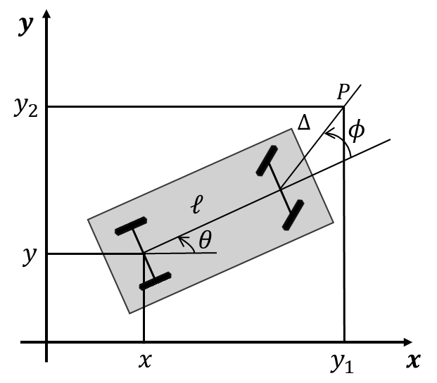
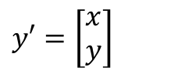
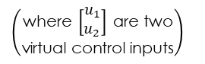
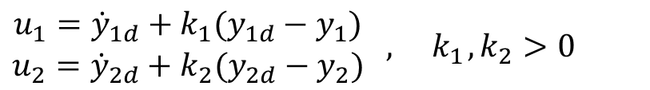
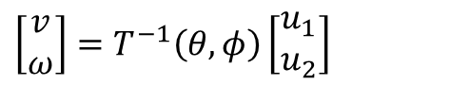
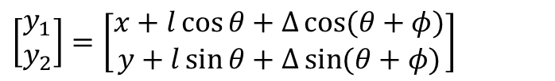
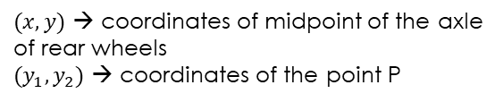
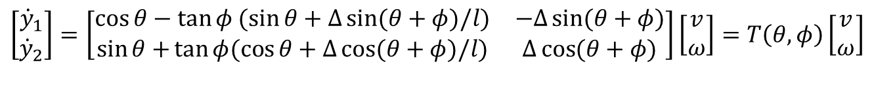
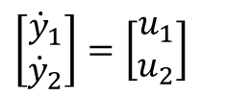
Input-Output Linearization control
The output choice for the trajectory tracking task is:
$$y′=\left[\begin{matrix}x \\ y\end{matrix}\right]$$
System output is redefined as:
$$\left[\begin{matrix}y_{1} \\ y_{2}\end{matrix}\right]=\left[\begin{matrix}x+l\cos{θ+Δ\cos{(θ+φ)}} \\ y+l\sin{θ+Δ\sin{(θ+φ)}}\end{matrix}\right]$$
The time derivatives of these outputs (substituting the kinematic model of the car-like robot) :
$$\left[\begin{matrix}{\dot{y}}_{1} \\ {\dot{y}}_{2}\end{matrix}\right]=\left[\begin{matrix}\cos{θ}−\tan{φ (\sin{θ+Δ\sin{(θ+φ)/l)}}} & −Δ\sin{(θ+φ)} \\ \sin{θ+}\tan{φ(\cos{θ+Δ\cos{(θ+φ)/l)}}} & Δ\cos{(θ+φ)}\end{matrix}\right]\left[\begin{matrix}v \\ ω\end{matrix}\right]=T\left(θ,φ\right)\left[\begin{matrix}v \\ ω\end{matrix}\right]$$
$$\left[\begin{matrix}{\dot{y}}_{1} \\ {\dot{y}}_{2}\end{matrix}\right]=\left[\begin{matrix}u_{1} \\ u_{2}\end{matrix}\right]$$
$$\left(\begin{matrix}\text{where} \left[\begin{matrix}u_{1} \\ u_{2}\end{matrix}\right] \text{are} \text{two} \\ \text{virtual} \text{control} \text{inputs}\end{matrix}\right)$$
Since $\det{T\left(θ,φ\right)=Δ/\cos{φ≠0}}$, we can set:
$(x,y)$ → coordinates of midpoint of the axle of rear wheels
$(y_{1},y_{2})$ → coordinates of the point P
Heading velocity and steering angle velocity:
$$\left[\begin{matrix}v \\ ω\end{matrix}\right]=T^{−1}\left(θ,φ\right)\left[\begin{matrix}u_{1} \\ u_{2}\end{matrix}\right]$$
Controller
$$\begin{matrix}u_{1}={\dot{y}}_{1d}+k_{1}(y_{1d}−y_{1}) \\ u_{2}={\dot{y}}_{2d}+k_{2}(y_{2d}−y_{2})\end{matrix} , { k}_{1}, k_{2}>0$$
15/28

Slide 16
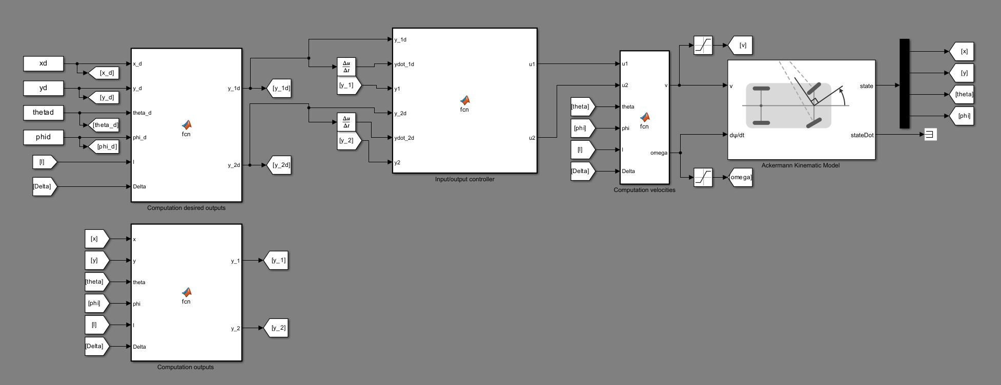
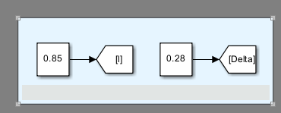
Input-Output Linearization control
Desired trajectory
Desired outputs
Virtual control inputs
Velocities
Current states
Current states
Outputs
16/28

Slide 17
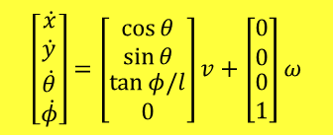
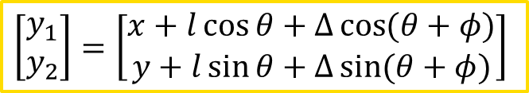
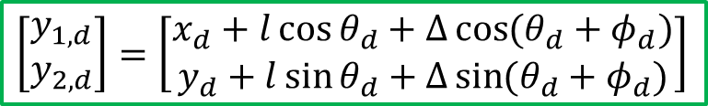
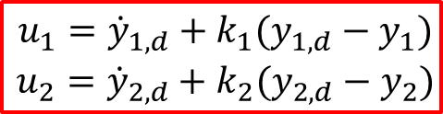
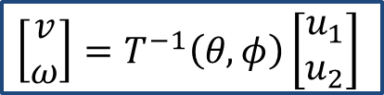
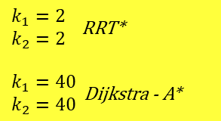
Input-Output Linearization control
$\begin{matrix}k_{1}=2 \\ k_{2}=2\end{matrix}$ RRT*
$\begin{matrix}k_{1}=40 \\ k_{2}=40\end{matrix}$ Dijkstra - A*
$$\left[\begin{matrix}\begin{matrix}\dot{x} \\ \dot{y}\end{matrix} \\ \begin{matrix}\dot{θ} \\ \dot{φ}\end{matrix}\end{matrix}\right]=\left[\begin{matrix}\begin{matrix}\cos{θ} \\ \sin{θ}\end{matrix} \\ \begin{matrix}\tan{φ/l} \\ 0\end{matrix}\end{matrix}\right]v+\left[\begin{matrix}\begin{matrix}0 \\ 0\end{matrix} \\ \begin{matrix}0 \\ 1\end{matrix}\end{matrix}\right]ω$$
$$\begin{matrix}u_{1}={\dot{y}}_{1,d}+k_{1}(y_{1,d}−y_{1}) \\ u_{2}={\dot{y}}_{2,d}+k_{2}(y_{2,d}−y_{2})\end{matrix}$$
$$\left[\begin{matrix}v \\ ω\end{matrix}\right]=T^{−1}\left(θ,φ\right)\left[\begin{matrix}u_{1} \\ u_{2}\end{matrix}\right]$$
$$\left[\begin{matrix}y_{1,d} \\ y_{2,d}\end{matrix}\right]=\left[\begin{matrix}x_{d}+l\cos{θ_{d}+Δ\cos{(θ_{d}+φ_{d})}} \\ y_{d}+l\sin{θ_{d}+Δ\sin{(θ_{d}+φ_{d})}}\end{matrix}\right]$$
$$\left[\begin{matrix}y_{1} \\ y_{2}\end{matrix}\right]=\left[\begin{matrix}x+l\cos{θ+Δ\cos{(θ+φ)}} \\ y+l\sin{θ+Δ\sin{(θ+φ)}}\end{matrix}\right]$$
17/28

Slide 18
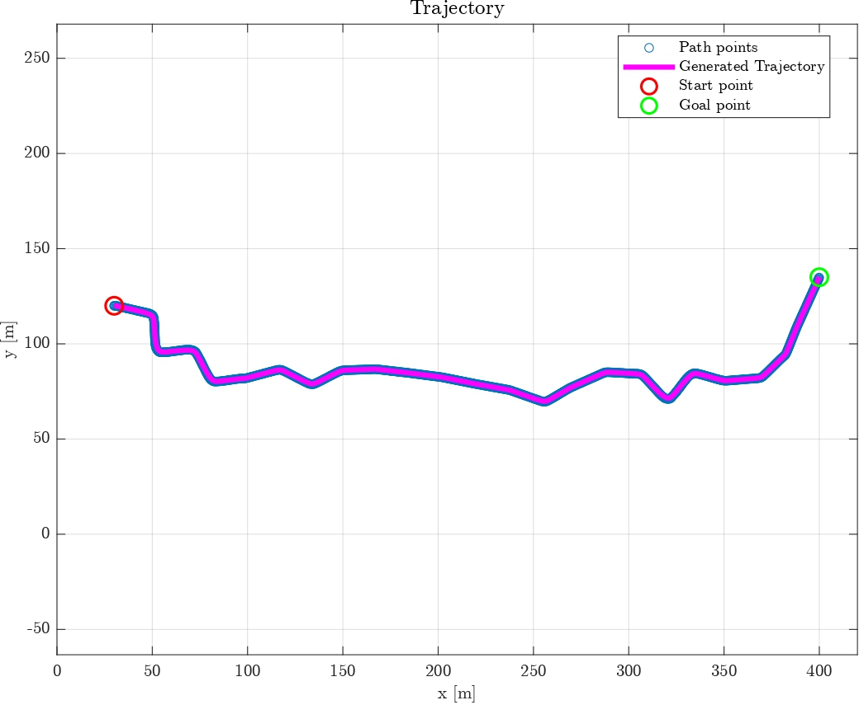
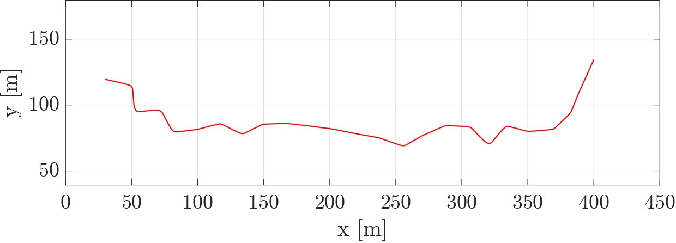
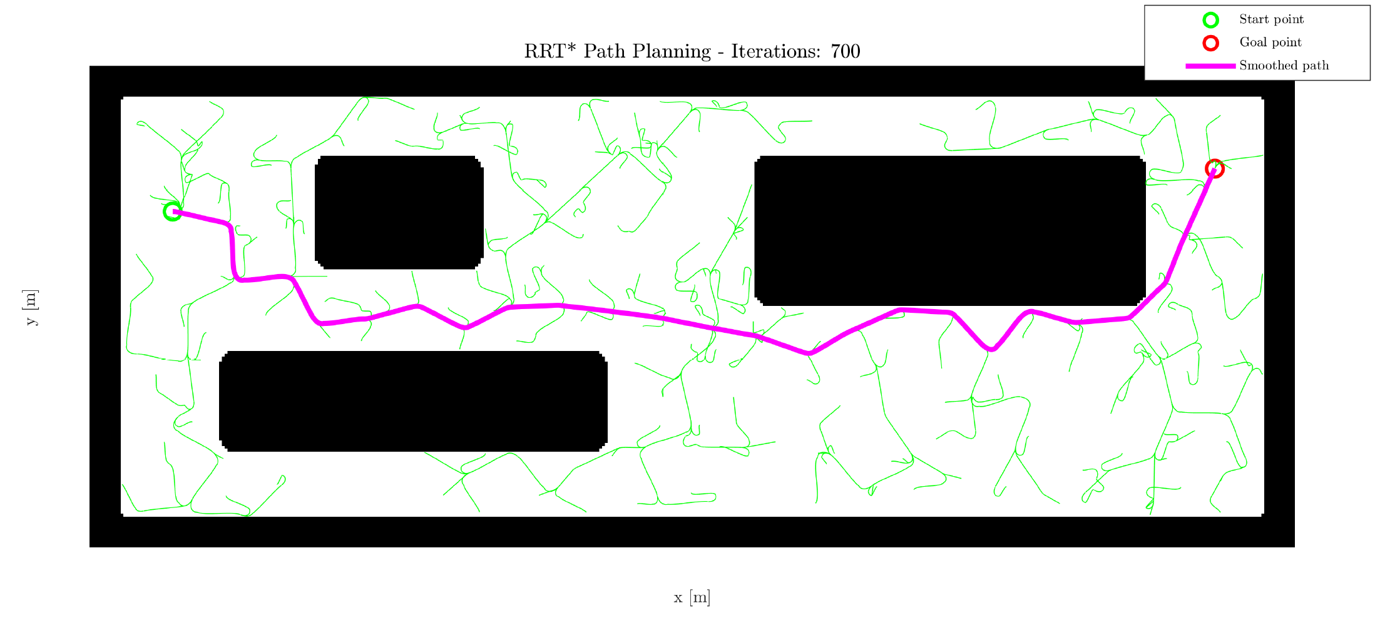

Simulations and Results: RRT* approach
Desired trajectory in SIMULINK
RRT* path finding
Desired trajectory in MATLAB
Performed trajectory in SIMULINK
18/28

Slide 19









Simulations and Results: RRT* approach
Error of $x$
Error of $y$
Error of $θ$
Error of $φ$
19/28

Slide 20


Simulations and Results: RRT* approach
Heading velocity and steering angle velocity in MATLAB
Heading velocity and steering angle velocity in SIMULINK
20/28

Slide 21





Simulations and Results: Dijkstra approach
Dijkstra path finding
Desired trajectory in SIMULINK
Desired trajectory in MATLAB
Smooth forced connection
Performed trajectory in SIMULINK
21/28

Slide 22






Simulations and Results: Dijkstra approach
Error of $x$
Error of $y$
Error of $θ$
Error of $φ$
22/28

Slide 23


Simulations and Results: Dijkstra approach
Heading velocity and steering angle velocity in MATLAB
Heading velocity and steering angle velocity in SIMULINK
23/28

Slide 24



Simulations and Results: A* (Manhattan) approach
A* path finding
Desired trajectory in SIMULINK
Desired trajectory in MATLAB
Smooth forced connection
Performed trajectory in SIMULINK
24/28

Slide 25





Simulations and Results: A* (Manhattan) approach
Error of $x$
Error of $y$
Error of $θ$
Error of $φ$
25/28

Slide 26


Simulations and Results: A* (Manhattan) approach
Heading velocity and steering angle velocity in MATLAB
Heading velocity and steering angle velocity in SIMULINK
26/28

Slide 27


Simulations and Results: Comparing A* and Dijkstra
Nodes comparison
Exploration ratio
27/28

Slide 28
Simulations and Results: Final considerations
Aspect | Sampling-based (RRT)* | Search-based (Dijkstra, A*)
Complexity | Well-suited for high-dimensional spaces and complex environments | May struggle with "curse of dimensionality" in high-dimensional spaces
Optimality | Converges to optimal solutions as the number of iteration increases | Designed to find optimal solutions within the discretized space
Convergence | Balances exploration with optimization, converging to optimality over time | May require significant computation time in complex environments
Hybrid solutions that combines the strengths of both the approaches have been developed :
Use sampling-based planners for initial rapid exploration
Switch to search-based approaches near the goal region
This combination balances efficient space exploration with optimality guarantees
28/28

Slide 29
Thank you for your attention !!
29/28

